Slide 1
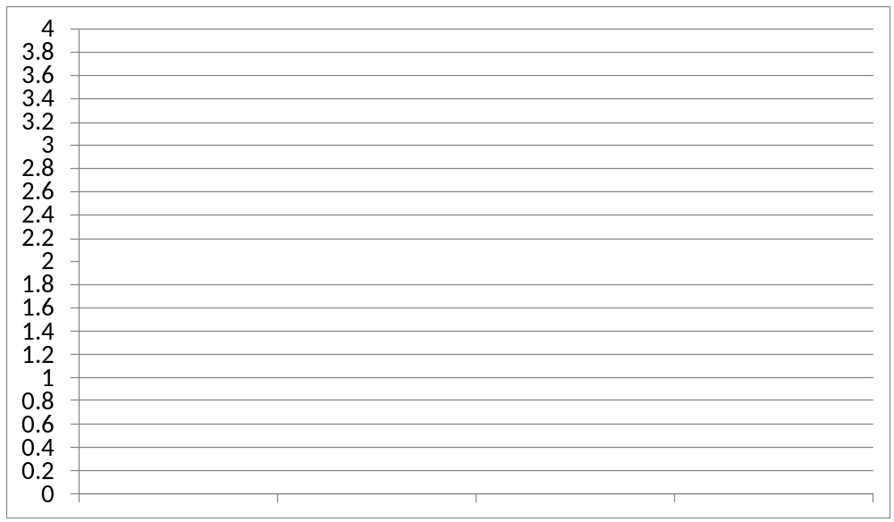


Held Shipments
000
Arriane
Habib
Ariel
John
Fazan
Kiren
Sameh
Total # Aging
BOS

Slide 2
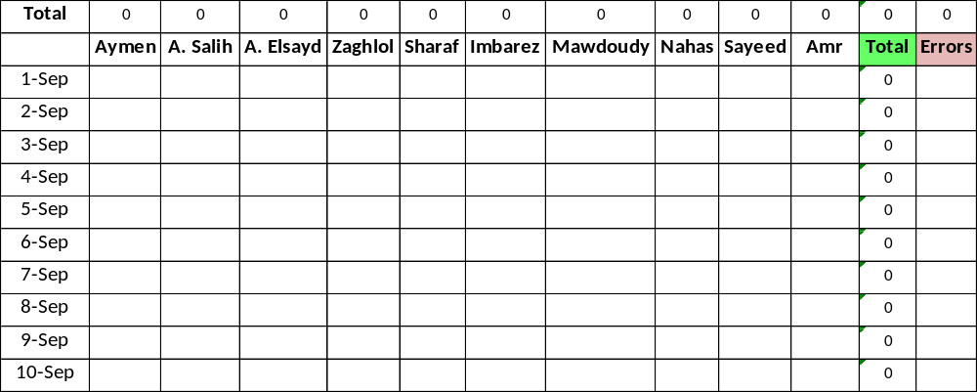
Bayan Agents Progress

Slide 3
Admin Team Progress
Counter
000
COA
QR008-LHR
00:00

Slide 4
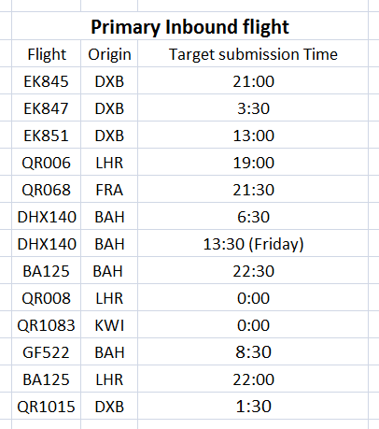
QR008-LHR
00:00
QR1083-KWI
00:00
QR1015-DXB
01:30
EK847-DXB
03:30
DHX140-BAH
06:30
GF522-BAH
08:30
EK851-DXB
13:00
DHX140-BAH
13:30
QR006-LHR
19:00
QR068-FRA
21:30
BA125-LHR
22:00
BA125-BAH
22:30

